Slide 1


Version ControL Using Git
Instructor:
Zaheer ul Hussain Sani

Slide 2
Discussion points
What is Git?
Why Git is Important?
How Git Works?
Basic Git Commands
Installing and Launching Git Bash
Creating and Publishing Git Repository
Use of Sourcetree Software for Git

Slide 3


What is Git?
Git is a Distributed Version-control System (DVCS) for tracking changes in source code during software development

Slide 4
WhY Git?
As a Student
As a Fresh Graduate
As a Professional Developer
As a Team Lead

Slide 5
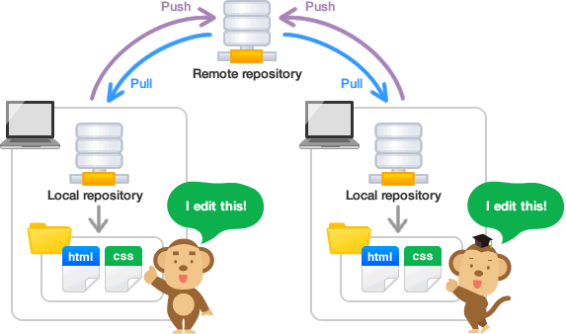
How Git works?

Slide 6
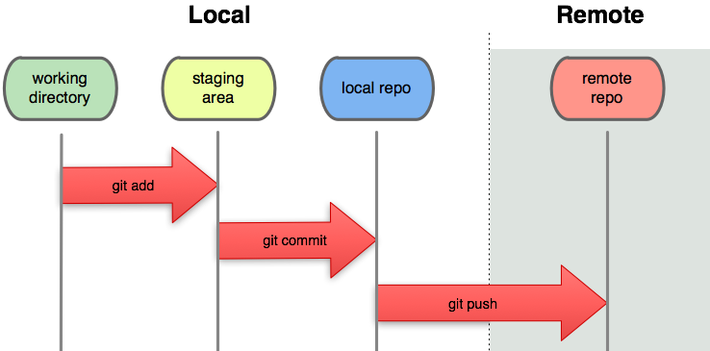
How Git works?

Slide 7
Git Commands
git init // Initialize Local Git Repository or Repo
git add // Add File(s)
git status // Check Status of Working Tree
git commit // Commit Changes
------------------------------------------------------------------------------------------
git push // Push To Remote Repository

Slide 8
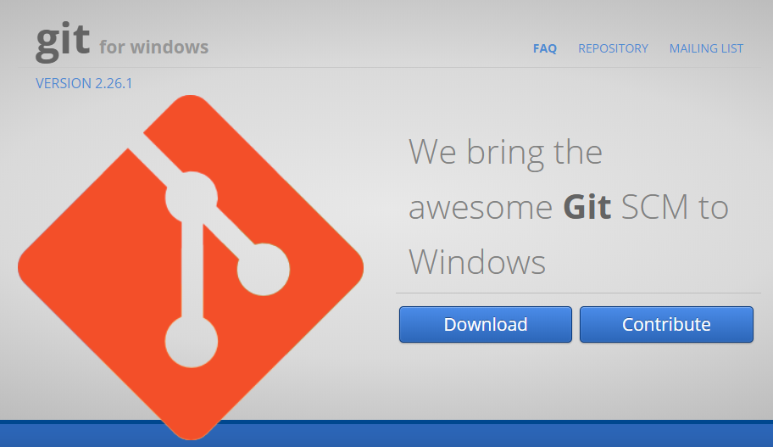
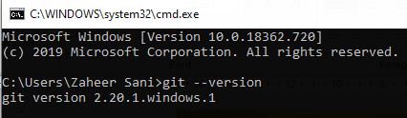
Git installation
Visit https://gitforwindows.org/

Slide 9
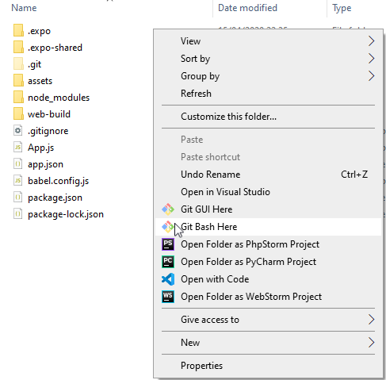
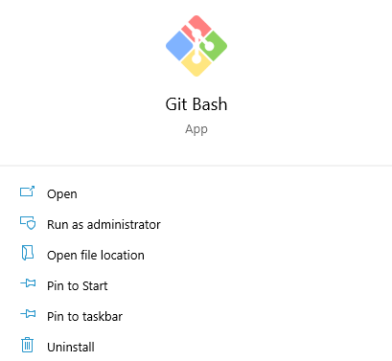
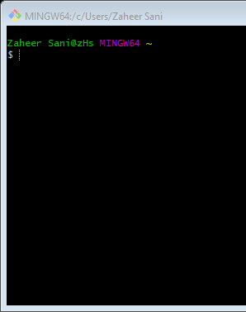
Launch Git bash

Slide 10
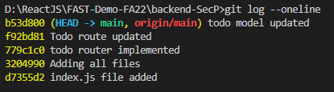
git log
You can check your commit history by running:
git log
The output shows a log of all the commits you have made, who made the commit, the date, and the commit notes.
Adding the --oneline flag shows the commit history condensed in one line. Omitting the flag shows a detailed commit history.
git log --oneline

Slide 11
git revert
If you have made mistakes during your project development or want to revert a commit for any reason, git revert allows you to do so.
The git revert command reverts a particular commit, i.e., undoes the commit you made to remove the changes from the master branch.
git revert [commit_ID]
Find commit IDs by running git log. The 7-character code is the commit ID.

Slide 12
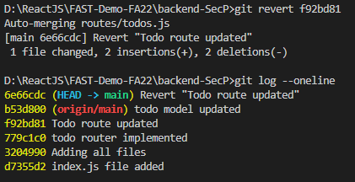
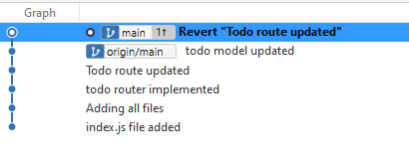
1
git revert
2

Slide 13
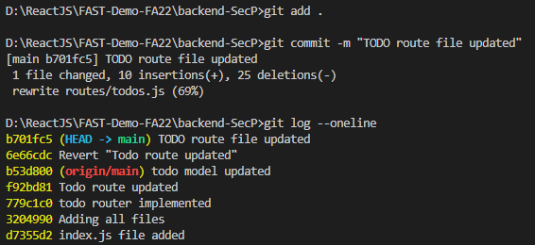
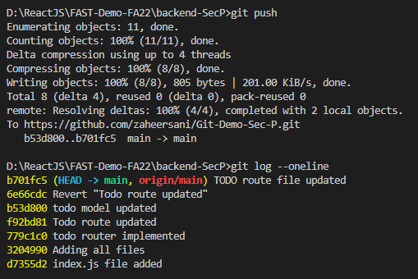
3
git revert
4

Slide 14
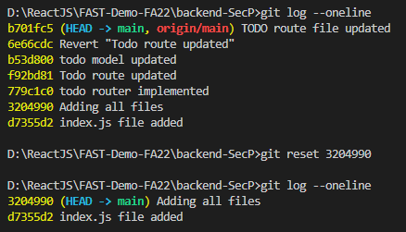
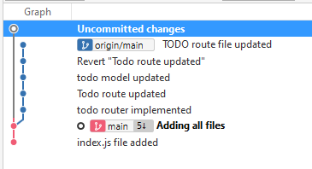
git reset
The git reset command permanently takes you back to a certain point in development.
All the files and changes added after that point in time are unstaged if you want to re-add them.

Slide 15
Branching
Branching is a feature in Git that allows developers to work on a copy of the original code to fix bugs or develop new features.
By working on a branch, developers don't affect the master branch until they want to implement the changes.
The master branch generally represents the stable version of your code, which is released or published.
That's why you should avoid adding new features and new code to the master branch if they are unstable.
Branching creates an isolated environment to try out the new features, and if you like them, you can merge them into the master branch.
If something goes wrong, you can delete the branch, and the master branch remains untouched.

Slide 16
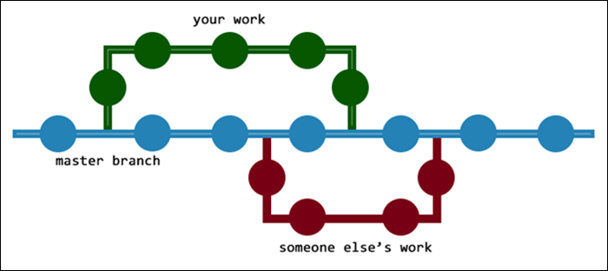
Branching

Slide 17
Branching
Check the branches
git branch -a
Create new branch
git branch [branch-name]

Slide 18
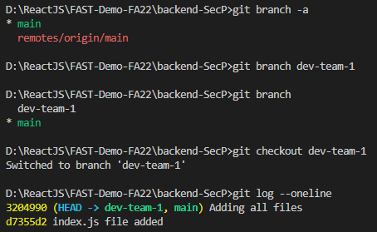
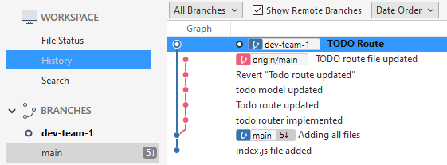
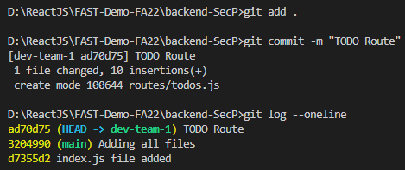
Branching

Slide 19
Branching
Switch to the master branch.
The git merge command requires you to be on the merge-receiving branch.
git checkout [master-branch-name]
After switching to the master branch, use the following syntax to merge your changes:
git merge [branch-name]

Slide 20
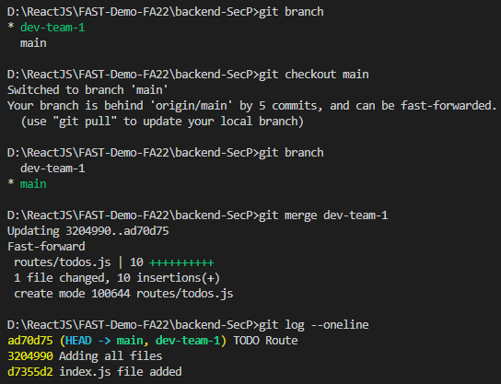
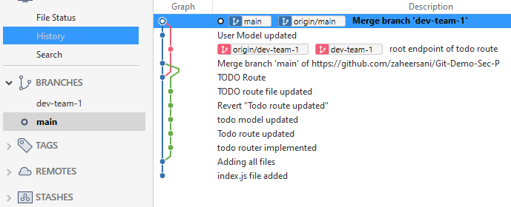
Branching

Slide 21
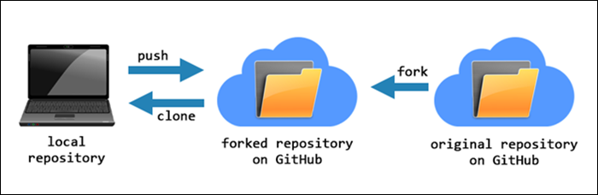
Forking
A fork is a complete copy of an existing repository that allows you to make changes and experiment without affecting the original project.
Forking is a way for someone to propose changes to an existing project, or it can be a starting point for a project of your own if the code is open source.
If you want to propose a change or a bug fix for a project, you can fork a repository, make the fix, and make a pull request to the project owner.

Slide 22
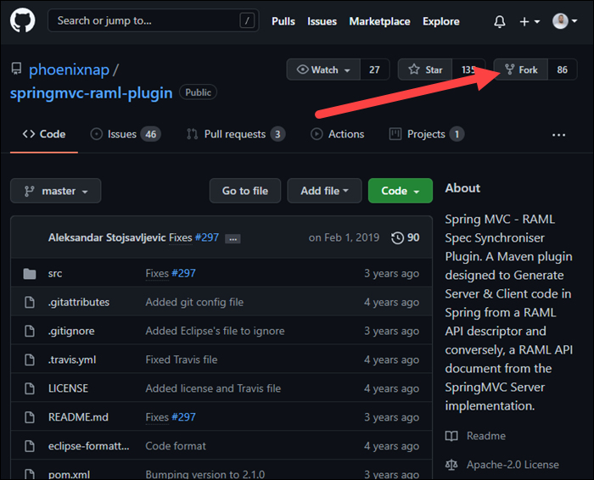
Visit the repository page on github and click the fork option.

Slide 23
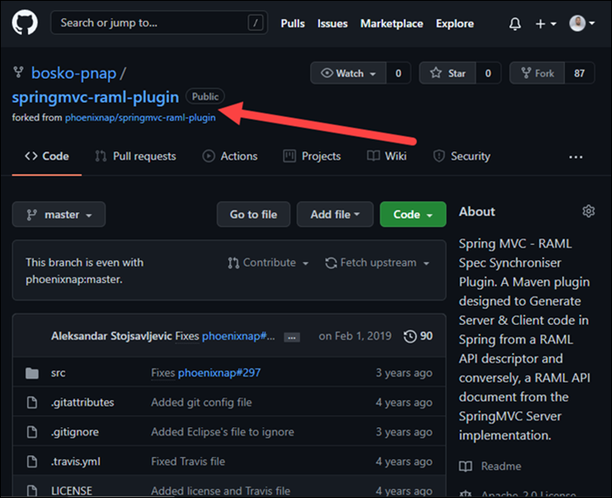
Wait for the forking process to complete. When it finishes, you will have a copy of the repository on your GitHub account.

Slide 24
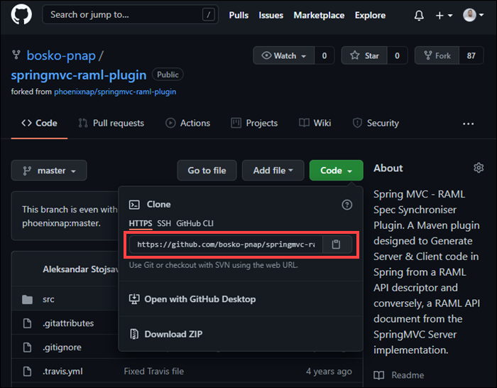
The next step is to take the repository URL from the Code section and clone the repository to your local machine.
Clone the repository using the following syntax:
git clone [repository URL]

Slide 25
References
Git Download Link
https://gitforwindows.org/
Video Tutorial (Git + React Native by Code Synergy)
https://www.youtube.com/watch?v=R79NZHD1A4I
Git Docs
https://git-scm.com/docs/git
Git Official Videos
https://git-scm.com/videos
Advance Git Commands [Forking, Branching, Merging, Rebasing etc]
https://phoenixnap.com/kb/how-git-works
20 Git Commands with Examples
https://dzone.com/articles/top-20-git-commands-with-examples

